Slide 1
CS 2212
Introduction to Software Engineering
Chapter 16 Software Reviews

Slide 2
Copyright Notice This Presentation and Its Associated Video Contain Copyright Material. This Presentation and Its Associated Video Are Provided for Teaching Purposes of CS2212 and Should Not Be Posted In Any External Site, Or Shared with. This Presentation and Its Associated Video Are Provided For Instructional Personal Use Only, and Only For The Purposes of the CS2212 Course.

Slide 3
Part 47
Software Review Definition and Metrics
That hardly ever happens is another way of saying 'it happens'.
― Douglas Crockford.
Notes:
This lesson introduces the basic steps in a software engineering project at a high level.
In practice, steps often overlap.

Slide 4
Learning Objectives in this Part
To learn about the concept and usefulness of Software Reviews
To learn about Software Review metrics

Slide 5
Review Techniques
“There is no particular reason why your friend and colleague cannot also be your sternest critic.”
- Jerry Weinberg

Slide 6
What Reviews Are
A meeting conducted by technical people for technical people
A technical assessment of a work product created during the software engineering process
A software quality assurance mechanism
A training ground

Slide 7
What Reviews Are
In essence, a review – any review – is a way of using the diversity of a group of people to:
Point out needed improvements in the product of a single person or team
Confirm those parts of a product in which improvement is either not desired or not needed
Achieve technical work of more uniform, or at least more predictable, quality than can be achieved without reviews, in order to make technical work more manageable

Slide 8
What Reviews Are Not
A project summary or progress assessment
A meeting intended solely to impart information
A mechanism for political or personal reprisal!

Slide 9
Types of Reviews
Software Peer Review. The aim is to assess the technical quality of a software component and it is usually conducted by the author of the code along with some fellow developers. It takes the form of:
Code Reviews
Pair Programming
Code Walkthroughs
Technical Review
Inspections
Software Management Review. The aim is to evaluates the status of the work and plan the project accordingly.
Software Audit Review. The aim is to assess the compliance of a software component against specifications and standards. It is an independent inspection conducted by external people who are not a part of the development team.

Slide 10
Cost Impact of Software Defects
Errors versus defects
Error—a quality problem found before the software is released to end users
Defect—a quality problem found only after the software has been released to end-users (also sometimes referred to as faults)
The primary objective of technical reviews is to find errors during the process so that they do not become defects after the release of the software
The obvious benefit of technical reviews is the early discovery of errors so that they do not propagate to the next step of the software process

Slide 11
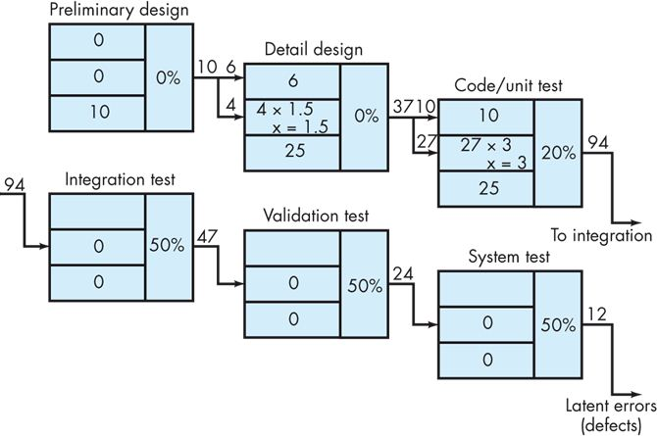
Defect Amplification and Removal
A hypothetical example of defect amplification. In this case, 10 preliminary design defects are amplified to 94 errors before testing commences, and 12 latent errors are released to the field. Testing helped, but did not fully remedy the situation.

Slide 12
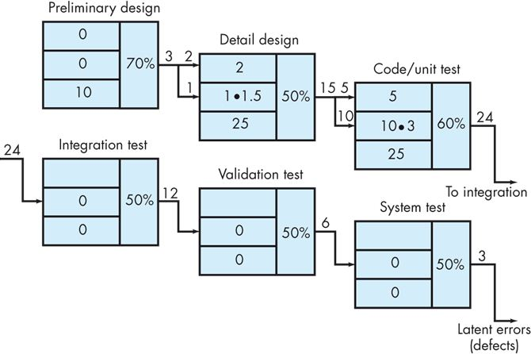
Defect Amplification and Removal
The same example, but now with design and code reviews conducted with each software engineering action. This time,
10 initial preliminary design issues are amplified to only 24 errors before testing and only 3 latent errors are released.

Slide 13
Review Metrics and Their Use
Preparation effort, E_{p} — the effort (in person-hours) required to review a work product prior to the actual review meeting
Assessment effort, E_{a} — the effort (in person-hours) that is expended during the actual review
Rework effort, E_{r} — the effort (in person-hours) that is dedicated to the correction of those errors uncovered during the review

Slide 14
Review Metrics and Their Use
Work product size, WPS — a measure of the size of the work product that has been reviewed (e.g., the number of UML models, or the number of document pages, or the number of lines of code)
Minor errors found, Err_{minor} — the number of errors found that can be categorized as minor (requiring less than some pre-specified effort to correct)
Major errors found, Err_{major} — the number of errors found that can be categorized as major (requiring more than some pre-specified effort to correct)

Slide 15
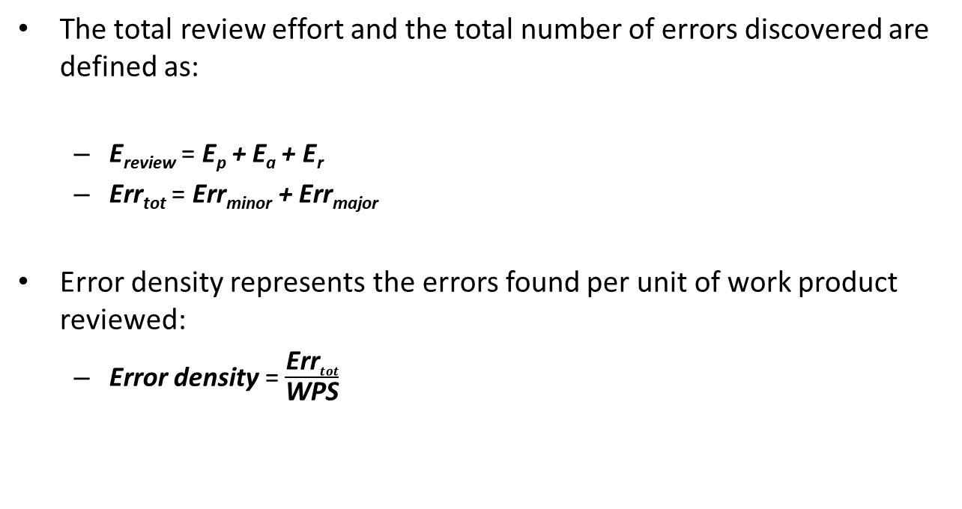
Review Metrics and Their Use
The total review effort and the total number of errors discovered are defined as:
E_{review} = E_{p} + E_{a} + E_{r}
Err_{tot} = Err_{minor} + Err_{major}
Error density represents the errors found per unit of work product reviewed:
Error density = $\frac{\text{Err}tot}{\text{WPS}}$

Slide 16
Review Metrics and Their Use – An Example
If past history indicates that:
The average error density for a requirements model is 0.6 errors per page, and a new requirement model is 32 pages long.
A rough estimate suggests that your software team will find about 19 or 20 errors during the review of the document.
If you find only 6 errors, you’ve done an extremely good job in developing the requirements model or your review approach was not thorough enough.

Slide 17
Review Metrics and Their Use – An Example
The effort required to correct a minor model error (immediately after the review) was found to require 4 person-hours.
The effort required for a major requirement error was found to be 18 person-hours.
Examining the review data collected, you find that minor errors occur about 6 times more frequently than major errors; therefore, you can estimate that the average effort to find and correct a requirements error during review is about 6 person-hours

Slide 18
Review Metrics and Their Use – An Example
Requirements related errors uncovered during testing require an average of 36 person-hours to find and correct
Using the averages noted, we get:
Effort saved per error = E_{testing} – E_{reviews} 36 – 6 = 30 person-hours/error
Since 22 errors were found during the review of the requirements model, a saving of about 660 person-hours of testing effort would be achieved, and that’s just for requirements-related errors

Slide 19
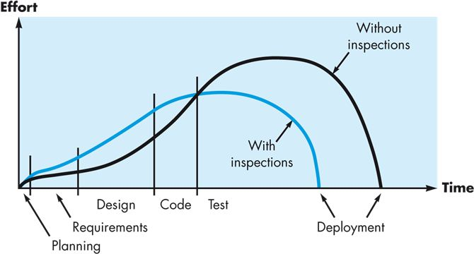
Cost Effectiveness of Reviews
Effort expended with and without reviews

Slide 20
Part 48
Software Review Reference Model
Be conservative in what you do, be liberal in what you accept from others
― Jon Postel.
Notes:
This lesson introduces the basic steps in a software engineering project at a high level.
In practice, steps often overlap.

Slide 21
Learning Objectives in this Part
To learn about a reference model for Software Reviews

Slide 22
A Reference Model for Reviews
Technical reviews should be applied with a level of formality that is appropriate for the software to be built, the project timeline and the people who are doing the work.
Four characteristics contribute to the formality with which a review is conducted; the formality of a review increases when:
Distinct roles are explicitly defined for the reviewers
There is a sufficient amount of planning and preparation for the review
A distinct structure for the review (including tasks and internal work products) is defined
Follow-up by the reviewers occurs for any corrections that are made

Slide 23
Informal Reviews
Informal reviews include:
A simple desk check of a software engineering work product with a colleague
A casual meeting (involving more than 2 people) for the purpose of reviewing a work product, or
The review-oriented aspects of pair programming
All of these approaches can have benefits to improving overall software quality

Slide 24
Informal Reviews
A simple desk check or a casual meeting is still a review, but because there is no advance planning, no agenda or meeting structure, and no follow-up on errors, the effectiveness of such reviews is considerably lower than more formal approaches
That said, they can still uncover issues that would otherwise propagate further into the software process
One way to improve the efficacy of these reviews is to develop a set of simple review checklists for each major work product produced
The questions posed in the checklist are somewhat generic, but they will serve to guide the reviewers as they check the work product
Pair programming encourages continuous review (like a continuous desk check) as a work product (design or code) is created.

Slide 25
Formal Technical Reviews
The objectives of a formal technical review (FTR) are:
To uncover errors in function, logic, or implementation for any representation of the software
To verify that the software under review meets its requirements
To ensure that the software has been represented according to predefined standards
To achieve software that is developed in a uniform manner
To make projects more manageable
The formal technical review is a class of reviews that includes walkthroughs and inspections

Slide 26
The Review Meeting
A review meeting for a work product will generally involve the following people:
Producer—the individual who has developed the work product; informs the project leader when the work product is complete and that a review is required
Review leader—evaluates the product for readiness, generates copies of product materials, and distributes them to two or three reviewers for advance preparation
Reviewer(s)—expected to spend between one to two hours reviewing the product, making notes, and otherwise becoming familiar with the work
Recorder—reviewer who records (in writing) all important issues raised during the review

Slide 27
The Review Meeting
At the end of the review meeting, all attendees must decide whether to:
Accept the product without further modification
Reject the product due to severe errors (once corrected, another review must be performed)
Accept the product provisionally (minor errors have been encountered and must be corrected, but no additional review will be required)
After the decision is made, all attendees complete a sign-off indicating their participation in the review and their concurrence with the review team’s findings

Slide 28
Review Guidelines
The following represents a minimum set of guidelines for reviews:
Review the product, not the producer
Set an agenda and maintain it; limit debate and rebuttal
Enunciate problem areas, but don't attempt to solve every problem noted
Take written notes
Limit the number of participants and insist upon advance preparation
Develop a checklist for each product that is likely to be reviewed
Allocate resources and schedule time for reviews
Conduct meaningful training for all reviewers
Review your early reviews

Slide 29
Sample-Driven Reviews
Ideally, every software engineering work product would undergo a formal technical review
In the real world of software projects, however, resources are limited and time is short
As a consequence, reviews are often skipped, even though their value as a quality control mechanism is recognized
In such situations, a sample-driven review process can be useful …

Slide 30
Sample-Driven Reviews
To be effective, the sample-driven process must attempt to quantify those work products that are primary targets for full reviews:
Inspect a fraction a_{i} of each software work product, i. Record the number of faults, f_{i} found within a_{i}.
Develop a gross estimate of the number of faults within work product i by multiplying f_{i} by 1/a_{i}.
Sort the work products in descending order according to the gross estimate of the number of faults in each.
Focus available review resources on those work products that have the highest estimated number of faults.

Slide 31
Post-Mortem Evaluations
Many lessons can be learned if a software team takes the time to evaluate the results of a software project after the software has been completed and delivered to end users
A post-mortem evaluation is a mechanism that can be used to determine what went right and what went wrong when software engineering process and practice are applied in a specific project
Unlike a review that focusses on a specific work product, a post-mortem examines the entire software project, often using a workshop format extended to the entire software team and other stakeholders, to suggest improvements to both process and practice going forward

Slide 32
Your Turn
Discuss what Code Walkthroughs, Technical Review, and Inspections are. What are their differences?
Discuss two pitfalls which may occur in sample-driven reviews.
Can you think of different techniques to select components to prioritize reviews? (hint: reliability, code metrics, failure intensity profiles, test results)
Check-out the content of the following sites:
https://en.wikipedia.org/wiki/Software_review
https://www.geeksforgeeks.org/software-engineering-software-review/
https://medium.com/swlh/the-seven-deadly-sins-of-software-reviews-b7180f86d365
https://smartbear.com/learn/code-review/guide-to-code-review-process/
https://smartbear.com/learn/code-review/agile-code-review-process/
https://www.usgs.gov/products/software/software-management/types-software-review
https://medium.com/palantir/code-review-best-practices-19e02780015f
https://www.infoq.com/articles/practices-better-code-reviews/
https://pm.stackexchange.com/questions/27950/priority-of-a-code-review-in-kanban

